Slide 1
Slide Template Summary
Use the layout button to pick appropriate slide types
Light and Dark background packs
Includes the following slide types
One-logo format: footer includes PRL logo, website, and page #
Two-logo format: footer includes PRL logo, DOE logo, website, and page #
Blank slides
Custom Designs:
PRL Title 1: with static image and PRL logo
PRL Title 2: with static image
PRL Title 3: with placeholder for custom image
PRL Title 4: with placeholder for custom image and PRL logo
Image with title

Slide 2
How to use the template
Click on the Layout button under the home tab to select among available template slides

Slide 3
I. Title Slides

Slide 4
Title slide #1 with full, static image and three lines of text

Slide 5
Title Slide #2
Static Image

Slide 6
Title Slide #3
Editable Image

Slide 7
Title Slide #4
Editable Image + Logo

Slide 8
Title Slide #5
Blank slide with one logo footer

Slide 9
Title Slide #6
Blank slide with two logo footer

Slide 10
II. Content Slides
All the following slides may be used with the one or two logo footer

Slide 11
Section Header slide
This is for a title for a subsection of your presentation. See the next slide for an example.

Slide 12
PROJECT A
Efficient and Robust Photosynthesis under Dynamic Conditions Project Lead: Dr. David Kramer

Slide 13
Title + Content
This is the main content slide. See the next slide for an example.

Slide 14
PRL Renewal Grant
Photosynthetic Energy Capture, Conversion and Storage: From Fundamental Mechanisms to Modular Engineering
Three projects:
Project A: Efficient and Robust Photosynthesis under Dynamic Conditions
Project B: Building and Maintaining the Biological Solar Panel
Project C: Structure, function, organization and engineering of photosynthetic modules in Cyanobacteria

Slide 15
Title + Two Column
See the next slide for an example.
Text or image here

Slide 16
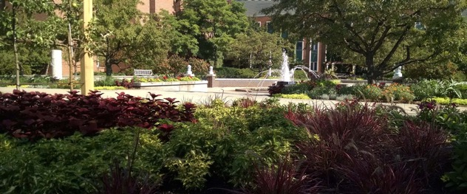
Title + Two Column
Over 50 years of collaboration between PRL and DOE
Top notch fundamental research
Educating future scientists to face 21st century global challenges
Cutting edge technology

Slide 17
Optional image with title
For the ‘wow’ factor

Slide 18
There is also the option for empty slides for those who like that space.

Slide 19
Dark Background Pack
There are analogous slides with dark backgrounds.

